Slide 1
Predicting Customer Satisfaction for Restaurants for Business Development and Revenues
Under the Guidance of
Mrs. Uma M (Asst Prof.(Sr.G))
1201310056 Mohit Ratnesh
1201310057 Sourabh Agarwal

Slide 2
Abstract
Customer Satisfaction is the main objective of any business to grow and develop in any positive way. Customer satisfaction is not the easy thing to achieve, it requires a lot of hard work and prediction to reach the ultimate decision that will make customer happy. In the era of technology, the customers are more complex and requires more services to satisfy them. Manual prediction are more intense that is not possible for single minds to keep track off. Therefore this application is created in such manner that it will help the business owners to predict the requirements of the customer and meet their demands. To do we have collected different data sets and feedback from different restaurant websites. To develop the business revenue, we have identified the two kind of customers (happy & sad) from the dataset and providing different level of offers according to customers. Hence it increases business development. J48 classifier used to increase the accuracy of prediction of the customer retention for restaurants.

Slide 3
Module Description
Feature Extraction
We used web scrapping a feature from python to gather different parameters used by the restaurants to get feedback and reviews from the customers.
Data Collection
During the extraction we collected different data provided by the users for the different restaurants and cleaned it as per the requirement of our project.
Classification
We used J48 Algorithm which is defined in WEKA Tool to predict and test the efficiency of the trained data set.

Slide 4
Module Description(contd..)
Apply Machine Learning
Applied different machine learning like J48 and Decision Table to check which one is best suited for our project.
Business Development Model
Developed a Web Application from where the End User and Customers can able to access the required data which will help then to develop and plan their business strategies according to the data gathered.

Slide 5
Existing Technologies
Innkey Restaurant POS
InnkeyPOS is the complete restaurant management system which covers total needs of your business lifecycle. It will act as your restaurant billing software and cover entire business operations like restaurant billing, sales, stocks, cost control, payroll and finance.
True Restaurant Management
True Restaurant is easy to use, full of the features a Bar uses many time, every day, and is very affordable price. True Restaurant Management software should have made order entry easier, make customers happier build a restaurant and Bar business.

Slide 6
Proposed Methodology
We will be delivering a product which will not only do the basic operations but will take customers reviews and feedback and also predict whether the customer is satisfied or not.
The product will help the Admin to plan their investment strategies as their will be wide range of data provided which will help them to analyze and plan.
The product is not limited to the certain level of organizations , it can be used by many different types of restaurants to improve their business strategies and increase their business revenue by analyzing the rate of customer satisfaction.

Slide 7
Algorithm
J48 or Decision Tree
It builds decision trees from a set of training data by using the concept of information entropy. The training data is a set of already classified samples. Each sample consists of a p-dimensional vector, where it represent attribute values or features of the sample, as well as the class in which it falls.
At each node of the tree, it chooses the attribute of the data that most effectively splits its set of samples into subsets enriched in one class or the other. The splitting criterion is the normalized information gain (difference in entropy). The attribute with the highest normalized information gain is chosen to make the decision. The C4.5 algorithm then recurs on the smaller sub-lists.

Slide 8
Problem Description
Who :This project problem is specifically addressed to the restaurants and restaurants based organisations.
What :This project problem is mainly Focused to increase the business development of the restaurants therefore it can only determine the customer related issues that affects the organisation not the internal issues of organisation till date.
When :This problem can occur many times at restaurant when people don’t come often therefore this can be used at this times to address the problems and attracts customers.

Slide 9
Where :This kind of problem occurs in small scale restaurants organisations which does not have much resources to counter the continuous market growth therefore this project can help them by investing very small amount of resources.
Why :This problem will help all the restaurant organisations to increase the productivity also it will help the customers to distinguish their restaurants more easily as it will try to provide all type of support possible to keep customer happy.

Slide 10
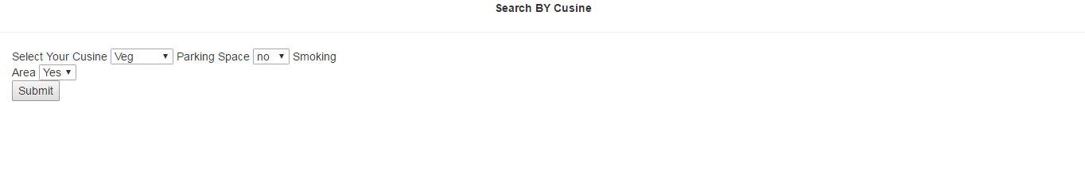
Prototyping
Fig :Food Prototyping Page

Slide 11
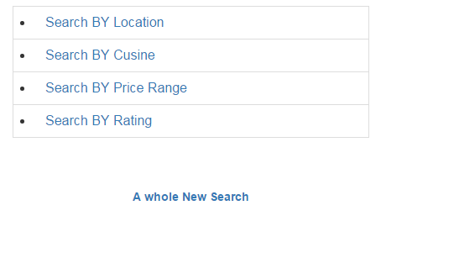
Fig : Prototyping of homepage

Slide 12
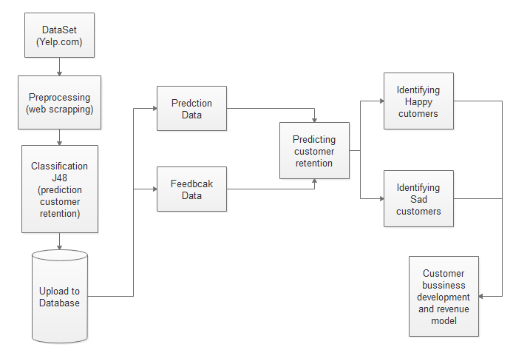
Architecture Diagram
Fig : Flowchart for the entire process

Slide 13
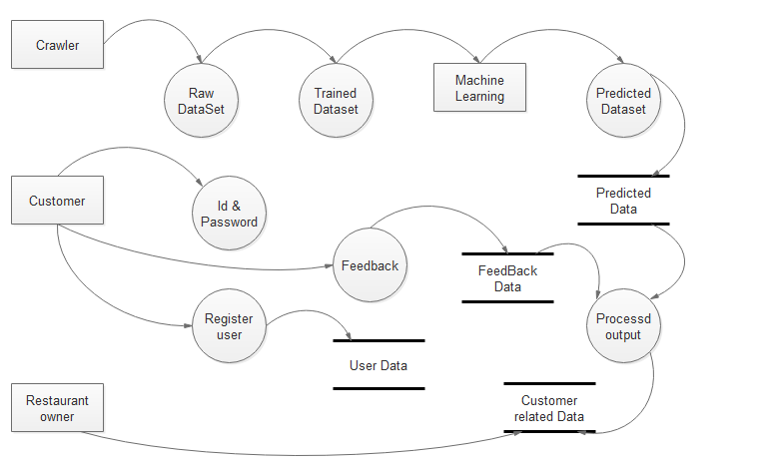
Data Flow Diagram

Slide 14
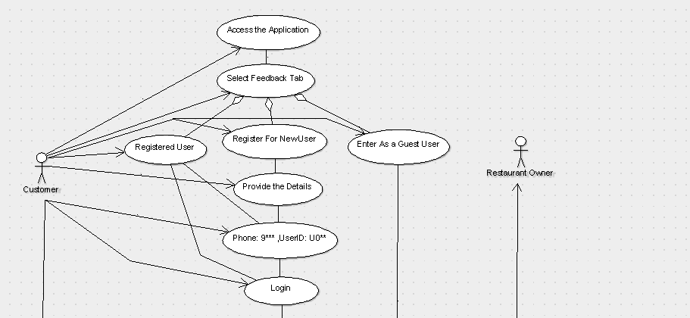
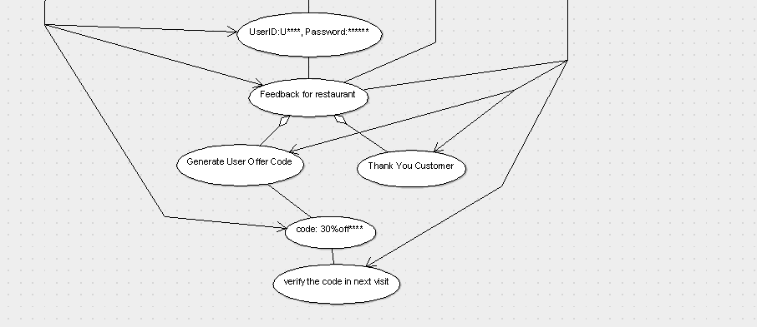
Fig : usecase diagram

Slide 15
Integration Testing
Integration testing is the testing done between the individuals modules to test whether they are compatible to each other or integrate with each other.

Slide 16
Testcase for Integration Testing
Test ID | Test Case | Procedure | Input | Expected output | Output | Remarks
T101-T110 | Integration Testing from homepage to admin page to valuable user page | Open homepage Click admin page Click valuable user | Open Click & wait Click & wait | No Error | No Error | Passed
T111-T113 | Integration Testing from homepage to Admin Page to most valuable user page to search particular user | Open homepage Click admin page Click valuable user Click select user Enter userId Click search | Open Click & wait Click & wait Click & wait Type Click & wait | No Error (user details) | No Error (user details) | passed
T114-T116 | Integration Testing from homepage to Admin Page to most valuable user page to search particular user | Open homepage Click admin page Click valuable user Click select user Enter userId Click search | Open Click & wait Click & wait Click & wait Type Click & wait | No Error (user details) | Error (internal server error) | Failed

Slide 17
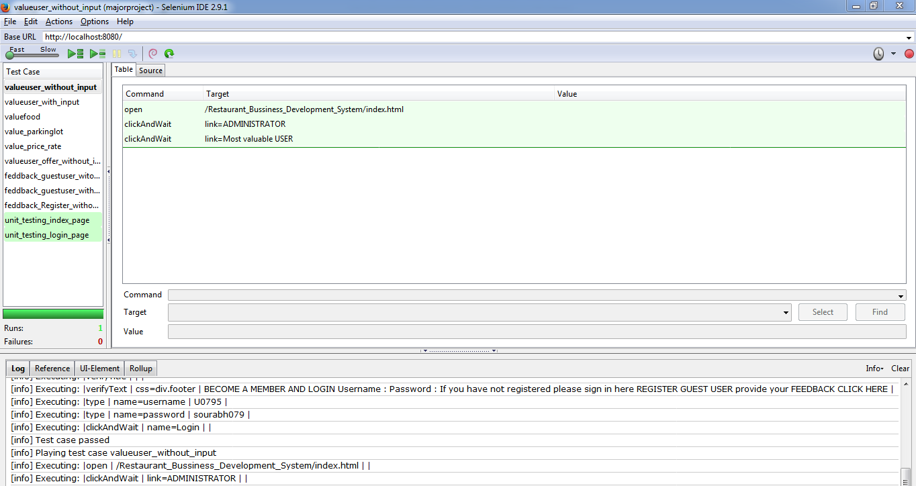
Integration Testing Output
Fig: Integration Testing TC101

Slide 18
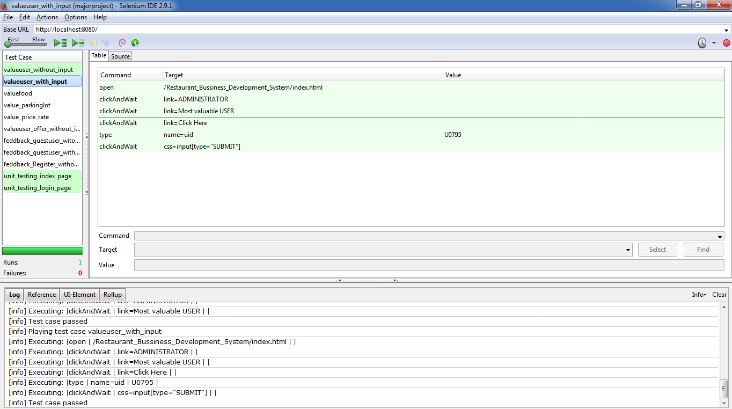
Integration Testing Output
Fig :Integration Testing TC 111-113

Slide 19
User Testing
User testing or Acceptance testing is the testing done to test the software interaction and working with real time scenario and environment.

Slide 20
User Testing TestCase
Test Id | User | Acceptance Requirement | Critical |  | Test Result |  | Comment
 |  |  | Yes | No | Accept | Reject
UT001 | Student | The application should work till End |  |  |  |  | Application predicted but UI can be Good.
UT002 | Student | The application should verify the offer code |  |  |  |  | Application verified the offer code satisfied.
UT003 | Student | Application should display data wrt, different features |  |  |  |  | Detail description should be better.

Slide 21
Size –LOC (lines of codes)
The Estimate lines of code was 2000.
The new estimated value for line of code came to be 2090 using sonar qube.
The sonar qube does not analyse the html, css and Jsp files.
Therefore including the Html and Jsp files the lines of code reached to 5200

Slide 22
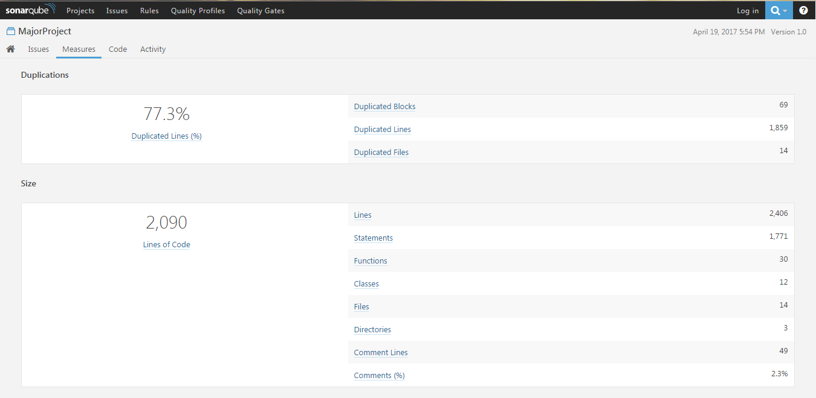
LOC Output
Fig: Lines of code by sonarqube

Slide 23
Cost Analysis
The lines of code reached out to be 5.2K for the project. Therefore,
Work Done Per person per month=3*(5.2)^1.12=19.012/month
Work Done by 2 person for 4 months= 2*19.012/4=9.506
Cost Estimation if We will take Rs 2 per LOC then Cost of the Project till now is= 2*9.506=RS.19.01K

Slide 24
Defect Analysis
It is the process of handling the defects fount during the different phases of the testing.
The defect report is a report with complete defect description and handling of the description.

Slide 25
Defect Report
Defect Report
ID | DT001
Project Name | Major Project
Product Name | Restaurant business development system (RBDS)
Release Version | 1.0
Module | DB Connectivity
Detect Build Version | 1.0
Summary | Oracle 10G jar file unstable for connection
Description | After Sometimes of execution the link to database terminates which causes unexpected error to application
Steps to replicate | Add Oracle 10G Jar file to the libraries of application. Clean and Build the Project. Run the Application N no of time till the connection breaks. Error occurs.
Actual Result | Internal Server error (Listener refuses problem)
Expected Result | Internal Server error (Listener refuses problem)
Attachment | -
Remarks | Execution failed
Defect Severity | High
Defect Priority | Primary
Reported By | Sourabh Agarwal
Assigned to | -
Status | pending
Fixed Build Version | Yet to release
Table : Defect report for DT001

Slide 26
Fishbone Diagram for Defect
Defect
Database
Servlet file
Directory
Connectivity file
Performance
Ram
Cpu Performance

Slide 27
Mc Call’s Quality Factor
Mc Calls’s Quality factor has 11 quality factors which helps in determining the quality of a software.

Slide 28
Mc Calls’s Quality Factor
MC Call’s Quality Factor
Correctness | The application has the correctness property as it predicts the customers visit for every feedback.
Reliability | The application is reliable and performs maximum functionality with correct precision.
Efficiency | The application is not Efficient for poorly configured system. But it can be efficient if directly executed in server.
Integrity | The application provides integrity to maximum extent by providing logging option on both ends. Still is vulnerable to hacking like (sql injection,etc).
Usability | The usability factor for the application is optimum and can easily operated and is user friendly.
Maintainability | The Application is highly maintainable as it requires updation of predicted datasets with certain interval of times.
Testability | The application is highly testable due to its modularity and mostly being a web application.
Flexibility | The flexibility of the application is optimum as it requires good knowledge of the code before making changes.
Portability | The application is highly portable because of being web application and can run in many browsers.
Reusability | The application is highly reusable of being distinguished modules which can be also used in different application.
Interoperability | The application is highly interoperable due to web application it can easily connect to different modules through links and other systems.
Table : Mc Call’s Quality Factor for RBDS

Slide 29
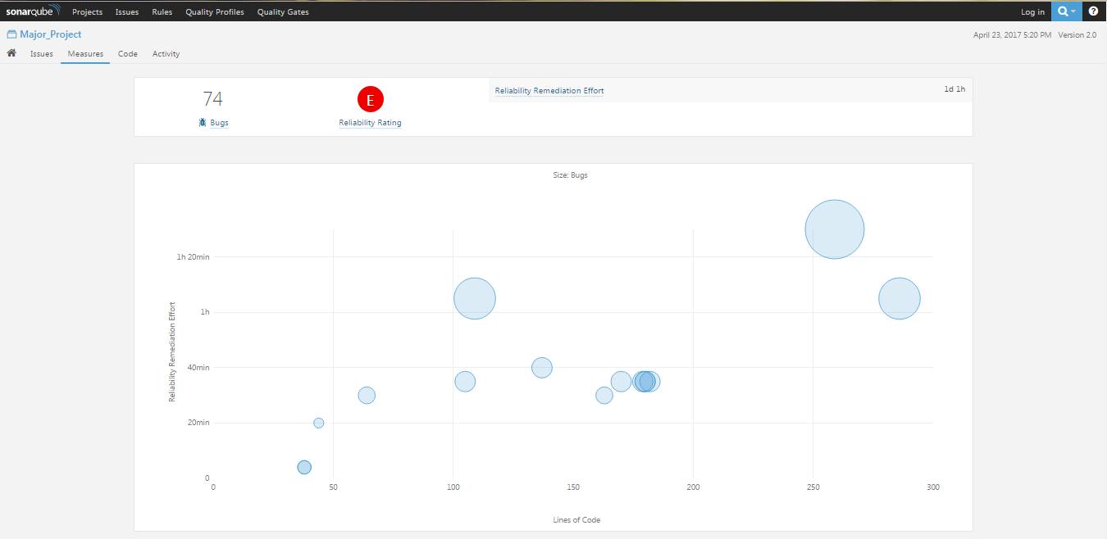
Mc Call’s Factors Output
Fig : Reliability Rating and Graph

Slide 30
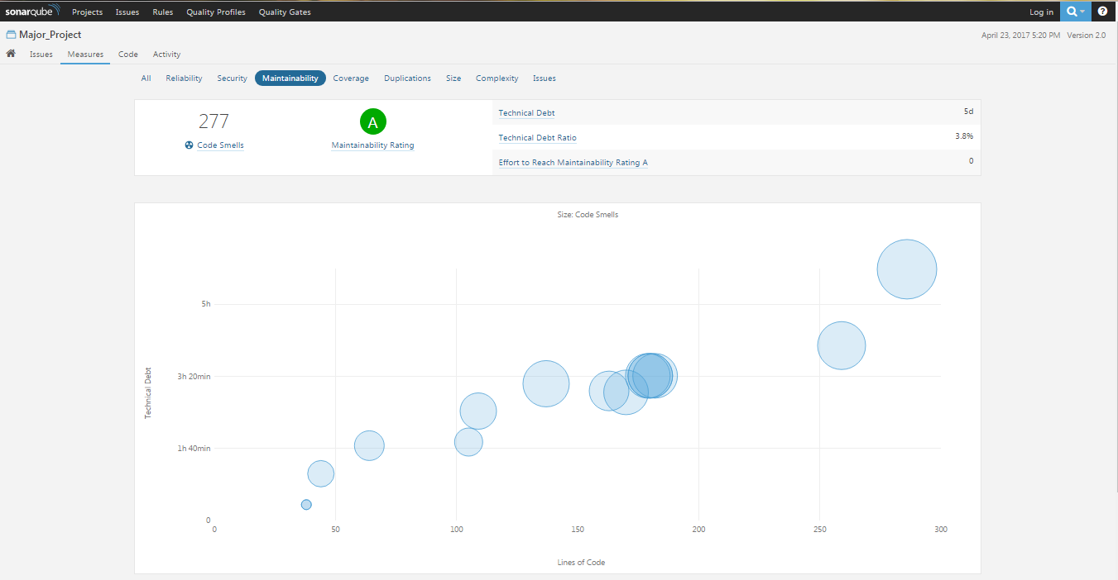
Mc Call’s Factor Output
Fig : Maintainability Rating and Graph

Slide 31
Result
The Application can successfully predict the customers visit.
The Application can successfully provide the offers to customers on the basis of feedback.
The owner can keep track of the resources that will help him to keep customer happy.

Slide 32
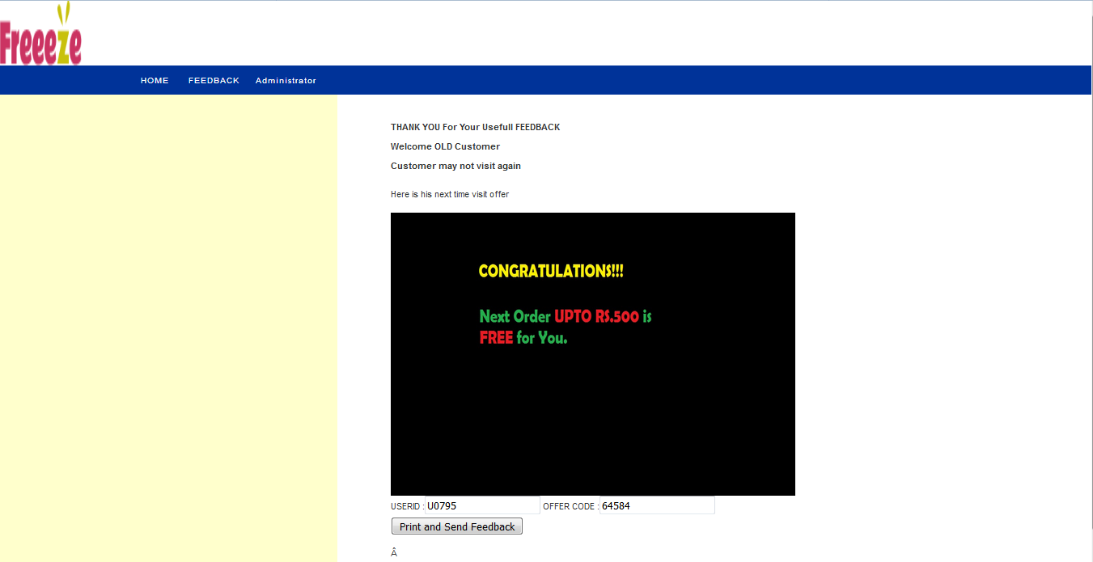
Result Output
Fig : Customer Predicting screen

Slide 33
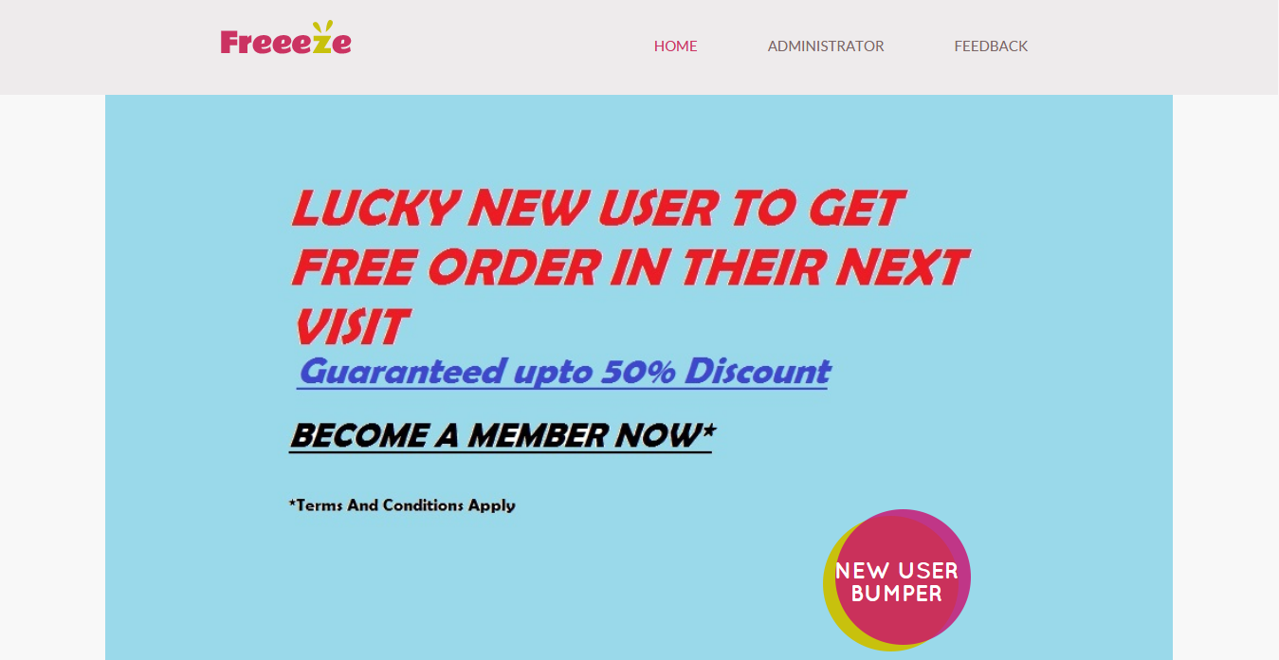
Result Output
Fig : Homepage of application

Slide 34
Result Analysis
Result analysis is done to compare the results that we have achieved is the only result or better results can be achieved.
The J48 or decision tree algorithm was selected because it had the 99.2308% correction value while in comparison to decision table algorithm which was used in referred journal it only produced 97.6923% correction value which ultimately leads us to the selection of J48 algorithm.

Slide 35
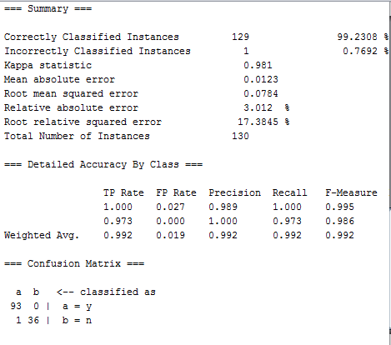
Result Analysis
Fig : Results of J48 Algorithm

Slide 36
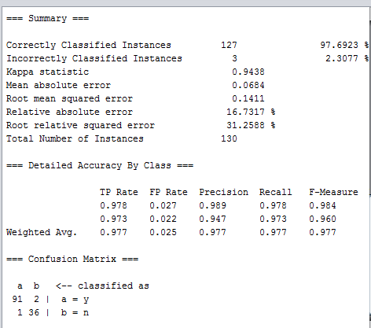
Result Analysis
Fig : Result of Decision table Algorithm

Slide 37
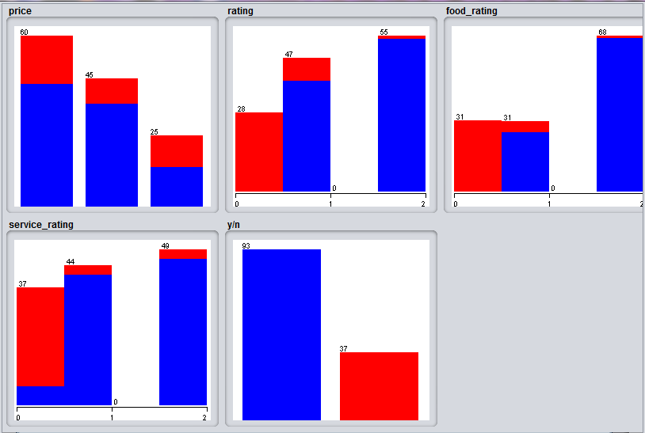
Result Analysis
Fig : J48 Classification algorithm statistics

Slide 38
Conclusion & Future Work
In The End we were able to develop a software which can help restaurant organizations and customers also. This application can also encourage to develop similar kind of software for various organization also.
In Future the customers can come to restaurants and can access the application through remote device and order food without any assist or can customize their order to save time.

Slide 39
Conclusion & Future Work
In Future organization can introduce swipe cards or RFID card to recharge their card and avail offers through it.
In Future organization or development team can make this product online by providing OTP instead of password.

